Slide 1
High Availability & Scalability For EC2
Presented by: Chinwuba Chidubem

Slide 2
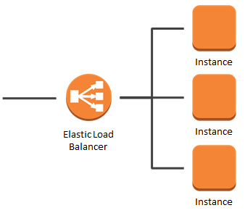
ARCHITECTURE

Slide 3
OUTLINE
Definitions
Create and configure EC2 instances
Create application load balancer
Create security group, define inbound and outbound rules
Register targets

Slide 4
What is load balancing?
Load Balances are servers that forward traffic to multiple servers (e.g., EC2 instances) downstream.
Why use a load balancer?
• Spread load across multiple downstream instances
• Expose a single point of access (DNS) to your application
• Seamlessly handle failures of downstream instances
• Do regular health checks to your instances
• Provide SSL termination (HTTPS) for your websites
• Enforce stickiness with cookies
• High availability across zones
• Separate public traffic from private traffic

Slide 5
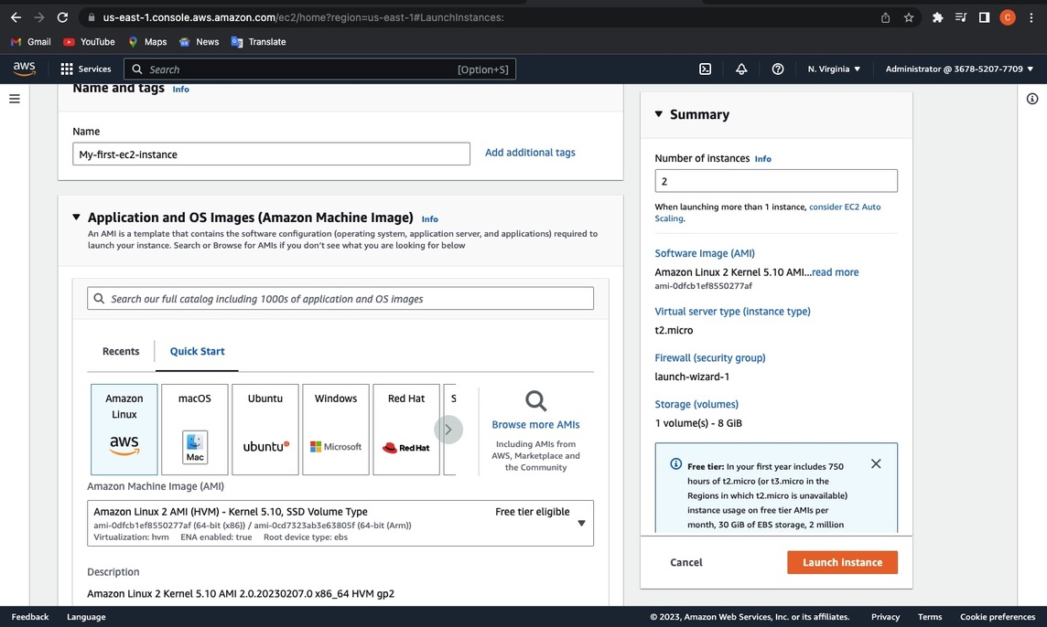
CREATE AND CONFIGURE EC2 INSTANCES

Slide 6
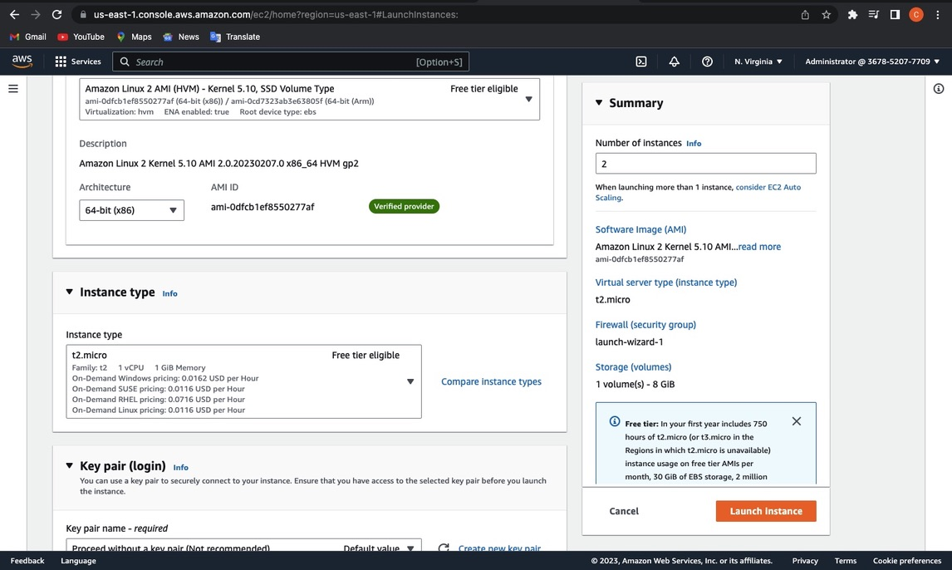

Slide 7
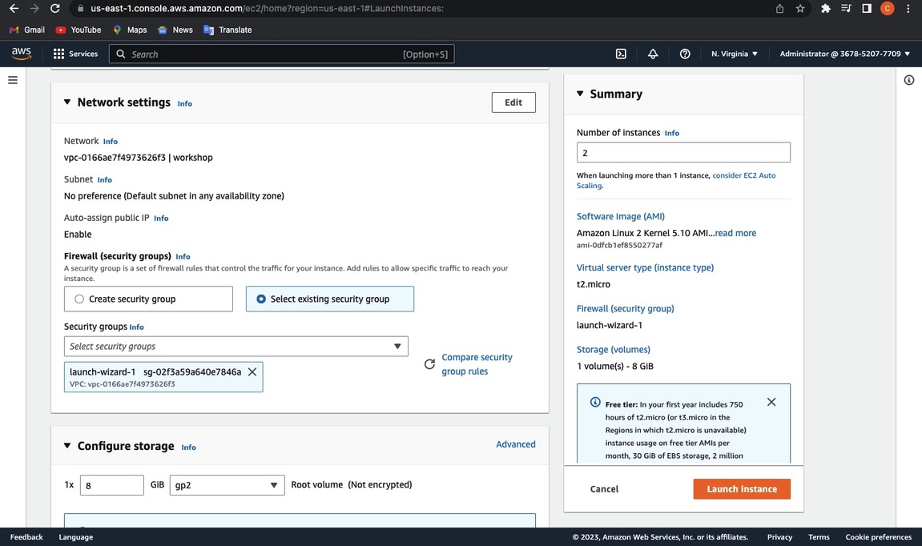

Slide 8
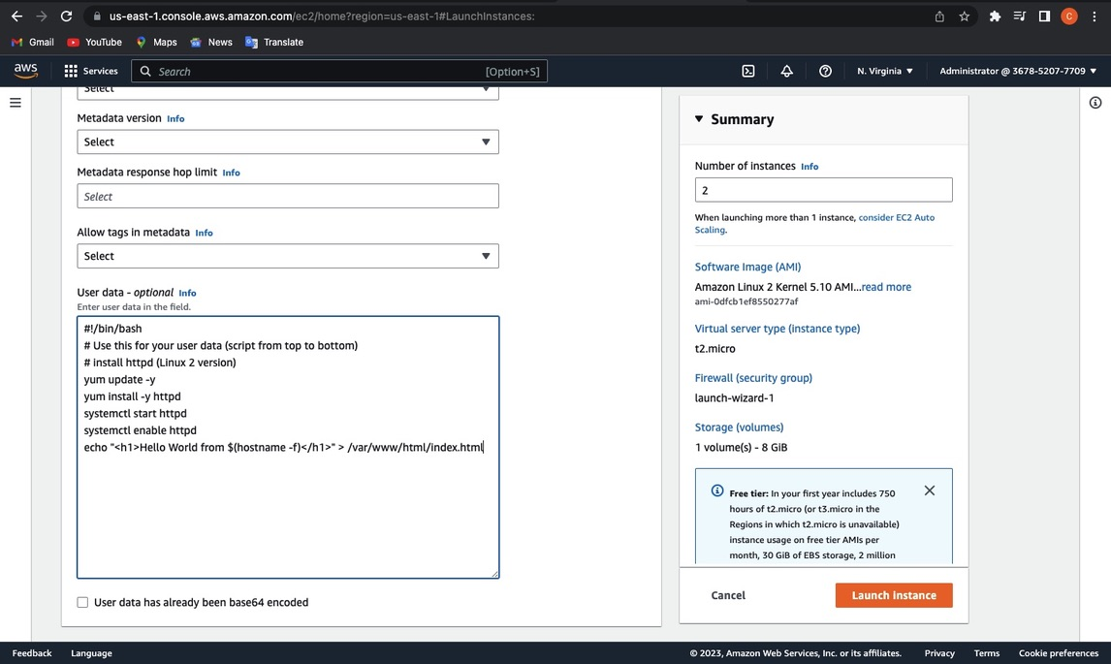

Slide 9
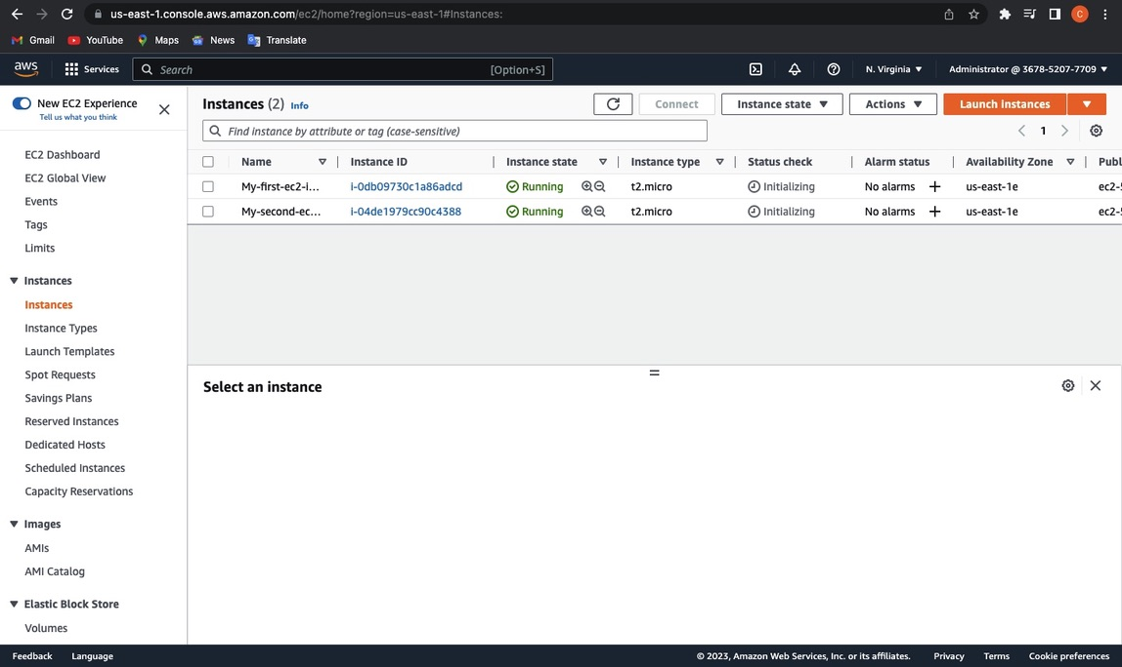

Slide 10
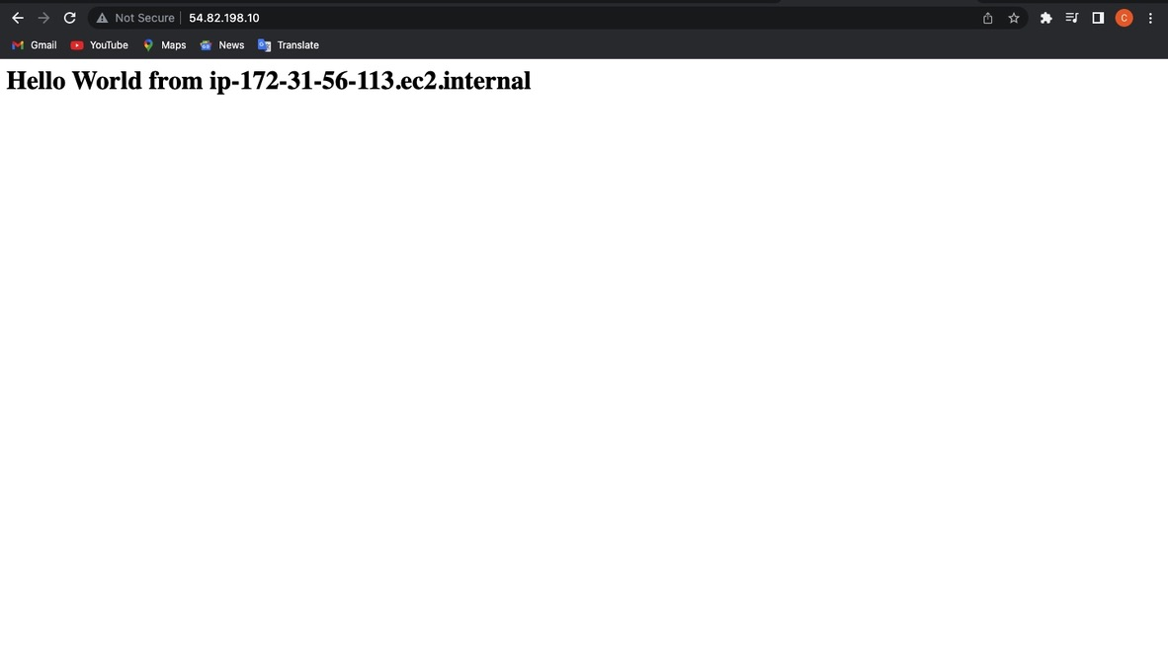

Slide 11
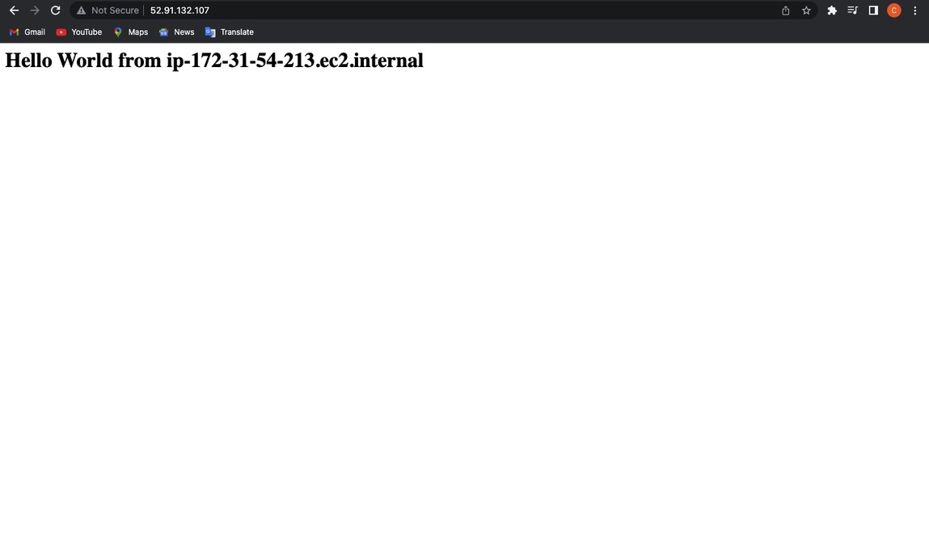

Slide 12
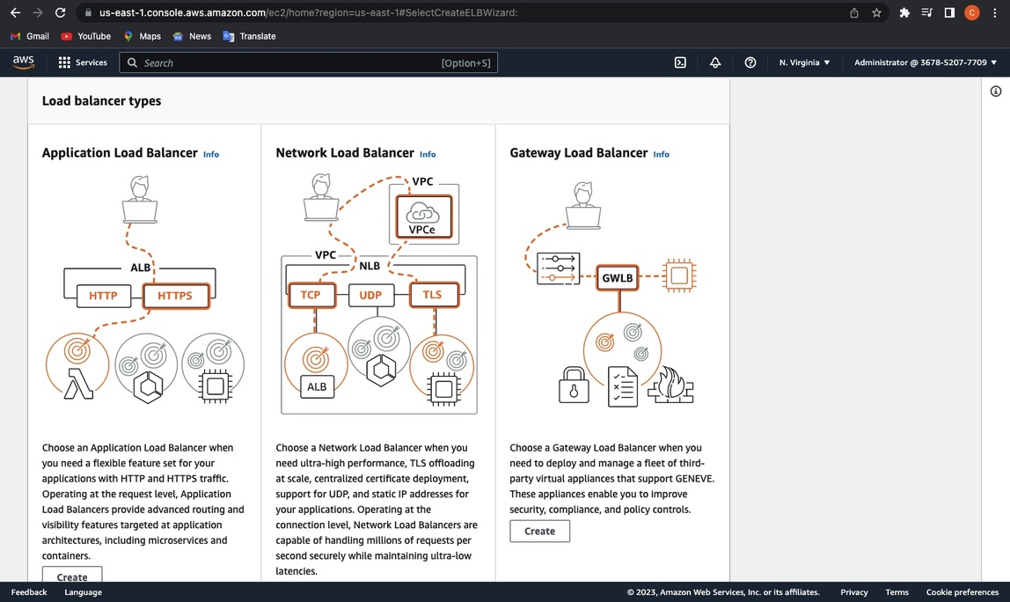
CREATE APPLICATION LOAD BALANCER

Slide 13
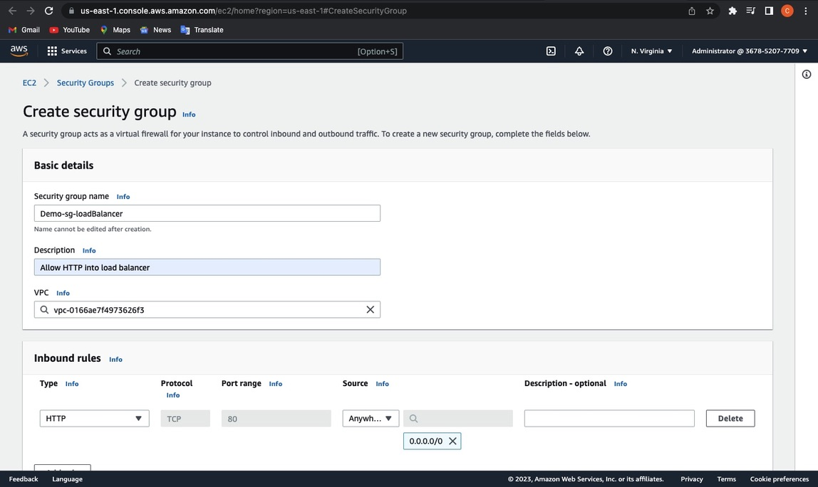

Slide 14
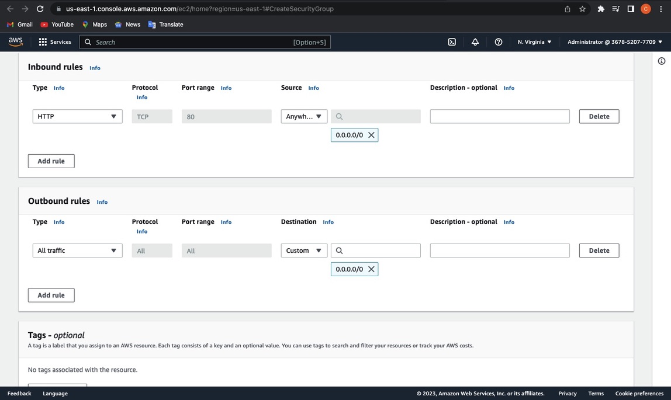

Slide 15
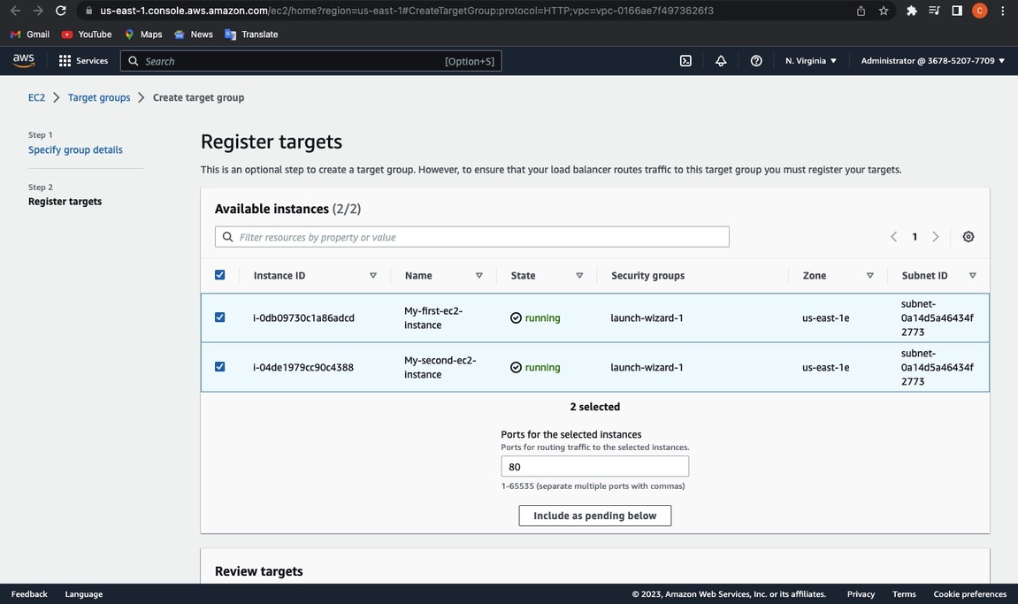
REGISTER TARGETS

Slide 16
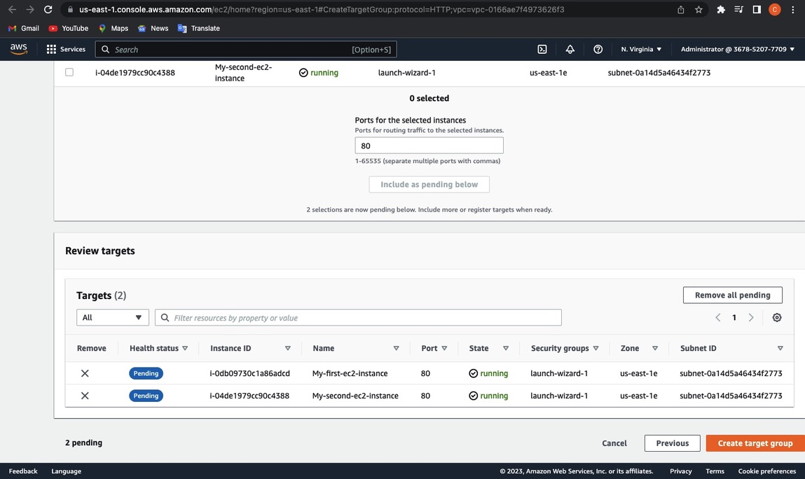
Continuation

Slide 17
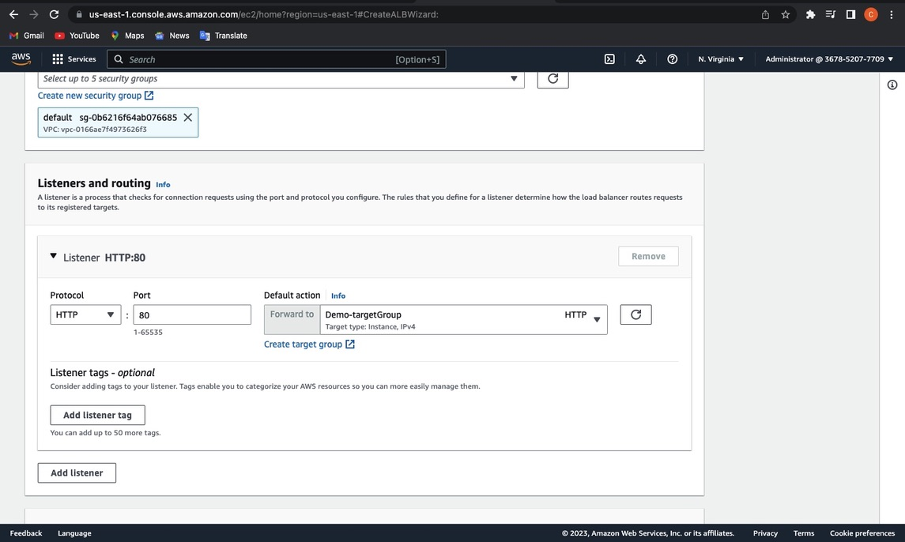
LISTENERS AND ROUTING

Slide 18
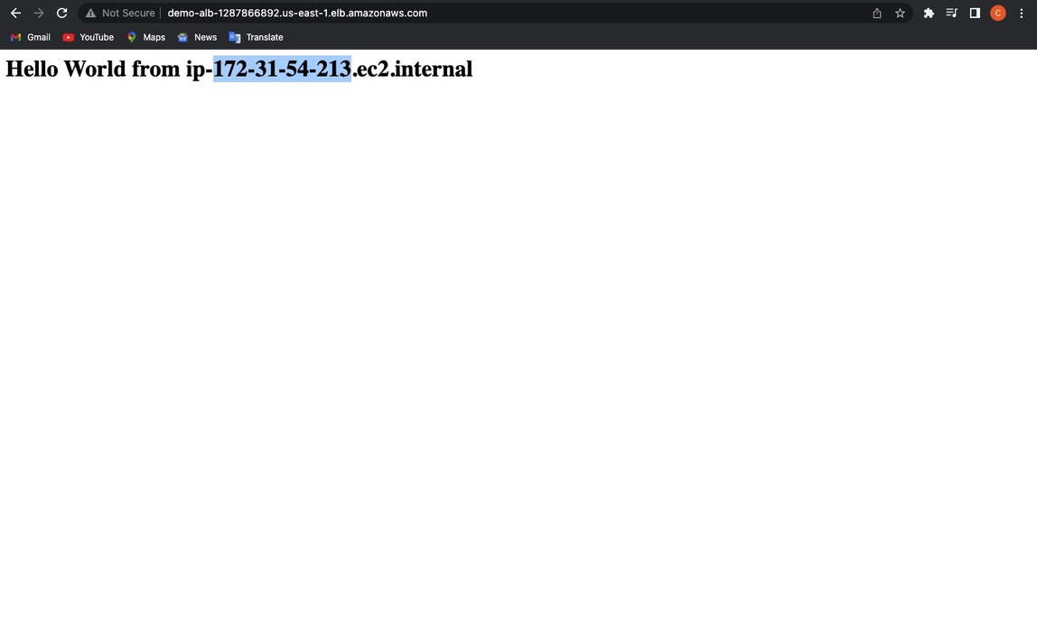
LOAD BALANCING

Slide 19
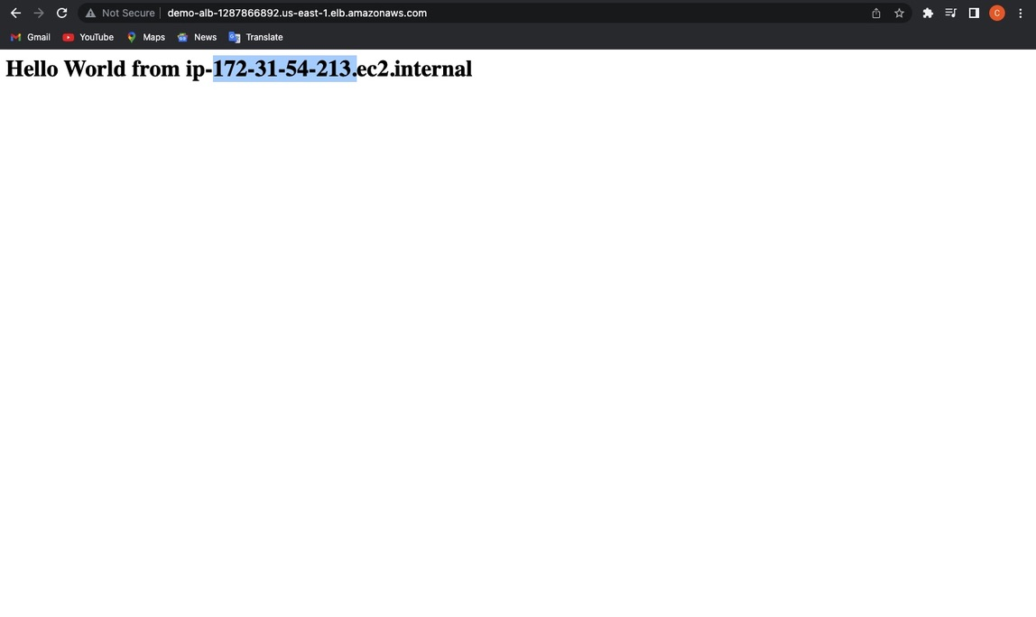

Slide 20


